Slide 1
HNDIT2417
Mobile Application Development
Fragments

Slide 2
Fragments
Fragment is a piece of an application's user interface or behavior that can be placed in an Activity which enable more modular activity design

Slide 3
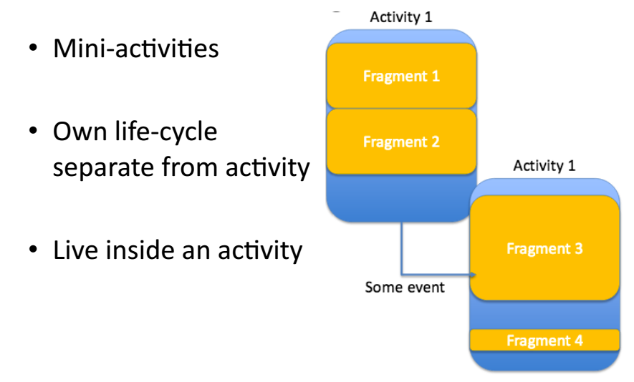
Fragments

Slide 4
Fragments
Fragments are created by
  Extending Fragment class
  Declaring the fragment in the activity's layout file, as a <fragment> element.
Fragments can add or remove while the activity is running.
A fragment can be used in multiple activities
Fragments were added to the Android API in Honeycomb version of
Android which has API version 11.

Slide 5
Advantage
Divide device screen and control different parts separately

Slide 6
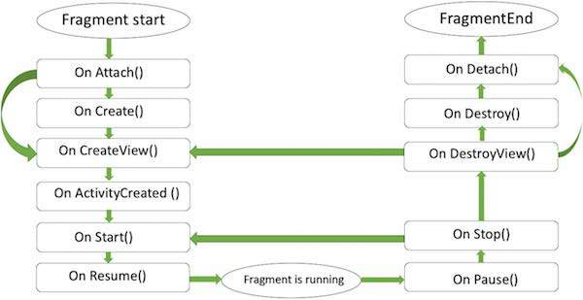
Life Cycle

Slide 7
Callback Methods
Callback method | Description
onAttach() | Called when a fragment is first attached to its context.
onCreate() | calls this method when creating the fragment.
onCreateView() | Calls when draw its user interface for the first time
onActivityCreated() | when the host activity is created
onStart() | When the fragment gets visible
onResume() | When Fragment becomes active
onPaused() | Calls when first indication that the user is leaving the fragment
onStop() | When Fragment going to be stopped

Slide 8
Callback Methods
Callback method | Description
onPaused() | When user is leaving the fragment
onDestroyView() | called when the view is removed from the activity’s view
onDestroy() | called to do final cleanup of the fragment's state.
onDetach() | called immediately prior to the fragment no longer being associated with its activity.

